Slide 1
About the Course
The long 20th century will in all likelihood be seen in the future as the watershed in human experience:
Nine aspects:
History was primarily economic—and that was true for the first time since the invention of agriculture…
Explosion of wealth: 2%+ per year…
Cornucopia of technology…
Feminist revolution…
Demographic transition…
Inclusion and hierarchy attenuation…
Empowered tyrannies…
Wealth gulfs…
Mismanagement and insecurity…
Humanity is unlikely to see as transformative—for good and ill, but mostly for good, so far at least, I think—a century again…

Slide 2
U.C. Berkeley: Economics 115: Spring 2020
20th Century Economic History: Lecture 7: Understanding the Great Depression
Brad DeLong
Department of Economics and Blum Center, U.C. Berkeley; and WCEG
delong@econ.berkeley.edu
last revised: 2020-02-12
for delivery: W 2020-02-26 17:00 HMMB390
<https://bcourses.berkeley.edu/courses/1487684>
<https://github.com/braddelong/public-files/blob/master/econ-115-lecture-7.pptx>

Slide 3
Preview
Falling in & Coming Out of the Great Depression
Takeaways from last time…
Administration
Review: The Perfect Storm of 1929-1933
Keynes’s Bottom Line
Alternatives to Let-It-Alone Marketism
Takeaways from this time…

Slide 4
To Your iClickers…
The midterm was:
Fair and easy—but now I am worried about how it will be curved…
Unfair and hard—and now I am really worried about how it will be curved…
Fair and hard—I am thankful I studied the right things…
Fair and hard—but now I am sad I studied the wrong things…
Unfair and easy—and now I am really worried about how it will be curved…

Slide 5
What Were the Takeaways from Last Lecture?
Causes, Nature, & Consequences of the Great Depression
Governments at the start of the Great Depression did not think that they ought to or needed to take an active role
Governments had to learn that they did—and those countries where governments learned quickest were the happiest
Cutting the gold standard tie quickest was best: the argument that staying on the gold standard would boost confidence and hence business willingness to invest in new plant and equipment turned out to be simply wrong, in the 1930s at least
Money hoarding—excess demand for cash, when private banks are not trusted to create cash and the government does not satisfy the demand—produces depression.

Slide 6
Econ 115: Administration: Office Hours &c.
DeLong: Office Hours
M 11:10-12:40, Blum Hall 200B
T 11:15-12:00, Blum Hall 200B
By appointment in Blum Hall 200B, Evans 691A, or elsewhere: email <delong@econ.berkeley.edu> Sign up at: <https://www.icloud.com/numbers/0leoOOlezWp6BYKSiPJhdXy7Q>
Assignment 6: will be out on Friday Feb 28; due Mar 8...
Memo: bCourses website <https://bcourses.berkeley.edu/courses/1487684>

Slide 7
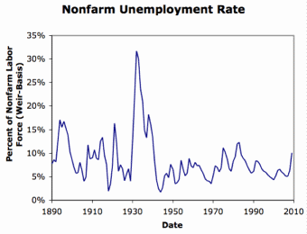
Review: Why the “Perfect Storm” of 1929-1933?
Previous Cycles:
1873—railroad
1884—railroad redux
1893—free silver
1904—Northern Securities
1907—gold drain to Britain
1914—disruption of the start of WWI
1920—deflation; return to “normalcy”
What brought previous downturns to a halt?
What made the Great Depression so great?

Slide 8
To Your iClickers…
How is it possible for market economies to produce a big depression?
When the government—or labor unions—fixes the real wage above the full-employment market-clearing level.
When the government imposes too heavy a tax burden and enterprise, and so businesses are unwilling to invest in adding to their capital stocks.
When there is an excess demand for money, when confidence in banks that can issue money is lacking, and when the government fails to step in and expand the money supply to satisfy the demand.
When it is necessary, due to changing demand, to switch production and employment from one sector to another.
None of the above.

Slide 9
General Glut
How is it that there can be a "general glut" in which pretty much every produced commodity and the labor of workers are in excess supply, given that humans are far from satiated with production goods and given that one person's expenditure is another person's income?
Remember: you can take your income and use it either to buy things that are useful or to build up your stock of cash money. If there is excess demand for useful commodities, people can switch from producing whatever they were making to producing whatever is in short supply.
But the only way to build up your stock of cash is to try to cut your spending below your income. And since one person's spending is another person's income, that simply cannot be done in general.
If people in general try, the result is that spending and incomes fall economywide until they are both at such a low level that people de-prioritize building up their cash holdings.

Slide 10
To Your iClickers…
Why was the interwar gold standard a source of weakness for economic stability?
There was nothing special about the interwar period: the gold standard was always a source of weakness for economic stability,
Because governments had gone off gold in World War I, investors were scared it would do so again and so unwilling to buy bonds; thus central banks had to push interest rates above the level consistent with full employment in order to preserve the gold standard.
Because governments had gone off gold in World War I, households were scared it would do so again and so wished to hoard lots of cash; central banks did not recognize this in time and to the appropriate degree.
There was nothing special about the interwar period: the gold standard was never a source of weakness for economic stability—it was failure to follow the gold standard’s rules that was the source of trouble.
None of the above.

Slide 11
Interwar Gold Standard
The interwar gold standard caused, deepened, and definitely did nothing toward curing or ameliorating the Great Depression…
There is nothing worse than attempting to credibly commit to an incredible policy
The fear that the gold standard would break down caused people to want to hoard cash—to build up their cash holdings.
The fear that the gold standard would break down caused governments to be extremely unwilling to boost their economies' cash supplies—such boosts might, governments feared, undermine confidence that their country would stay on the gold standard.
Big depressions happen when the popular demand for cash outstrips the government's supply
The role of France and the U.S.’s gold-hoarding policy
Fear of inflation: Crying “Fire! Fire!” in Noah’s Flood
The interwar gold standard was thus a powerful motivator and stage-setter pushing both people and governments into the patterns of behavior that produced the Great Depression

Slide 12
The Presumption Before the Great Depression
The presumption before the Great Depression that the government was not responsible for managing and curing the business cycle…
Two strands reinforced each other.
The first was the strength of the idea of laissez-faire: that government (protecting property and enforcing contracts aside) was overwhelmingly a problem and not a solution. As John Maynard Keynes wrote in his essay The End of Laissez-Faire, a powerful drive behind that was: “the corruption and incompetence of eighteenth-century government…. Almost everything which the State did in the eighteenth century in excess of its minimum functions was, or seemed, injurious or unsuccessful. [And] on the other hand, material progress between 1750 and 1850 came from individual initiative…”
The second was social Darwinism—that, in the words of steelmaster Andrew Carnegie, the second-richest man in America circa 1905 and a man who gave away his entire fortune: “The price we pay for [our civilization]... is, no doubt, great.... The employer of thousands is forced into the strictest economies... [in] the rates paid to labor.... The law of competition... is here; we cannot evade it; no substitutes for it have been found; and while the law may be sometimes hard for the individual, it is best for the race, because it insures the survival of the fittest in every department..."
The result was a dominant belief—at least among the rich and powerful—that:
The market giveth, the market taketh away: blessed be the name of the market.

Slide 13
The Hoover Administration’s Reaction to the Great Depression
The 1929-1933 Hoover administration believed that little could be done.
That the only good things that could be done were to (a) repeatedly state that "prosperity is just around the corner" and (b) try to cut federal government spending and raise taxes in order to restore confidence and scotch the fear of high inflation.
As economist R.G. Hawtrey wrote, to worry about inflation in the midst of the Great Depression was like "crying 'FIRE! FIRE!' in Noah's Flood..."
Herbert Hoover himself wrote afterwards about how his administration had been dominated by the "'leave-it-alone liquidationists' headed by Secretary of the Treasury Mellon, [who] felt that government must keep its hands off and let the slump liquidate itself. Mr. Mellon had only one formula:
'Liquidate labor, liquidate stocks, liquidate the farmers, liquidate real estate'. He held that even panic was not altogether a bad thing. He said: 'It will purge the rottenness out of the system. High costs of living and high living will come down. People will work harder, live a more moral life. Values will be adjusted, and enterprising people will pick up the wrecks from less competent people'…"
Hoover went on to state that he did not share this view…
That raises lots of questions about how his administration worked…

Slide 14
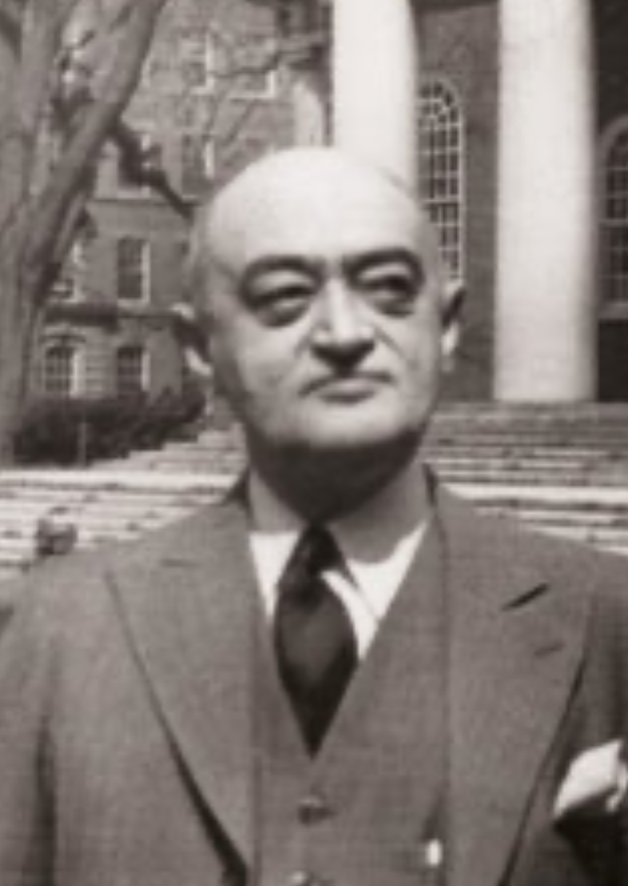
Joseph Schumpeter
Whatever is, & is in the market system, is rational:
“The problems presented by periods of depression may be grouped as follows:
“First, removal of extra economic injuries to the economic mechanism: Mostly impossible on political grounds.
“Second, relief… imperative on moral and social grounds… although no cure for fundamental cases.
“Third, remedies: The chief difficulty of which lies in the fact that depressions are not simply evils, which we might attempt to suppress, but—perhaps undesirable—forms of something which has to be done, namely, adjustment to previous economic change.

Slide 15
Joseph Schumpeter II
Whatever is, & is in the market system, is rational:
“Most of what would be effective in remedying a depression would be equally effective in preventing this adjustment. This is especially true of inflation, which would, if pushed far enough, undoubtedly turn depression in to the sham prosperity so familiar from European postwar [i.e., World War I] experience, but which, if it be carried to that point, would, in the end, lead to a collapse worse than the one it was called in to remedy….
“Fourth, reforms of institutions intended to remedy the situation but suggested by the moral and economic evils of both booms and depressions…. A political atmosphere exceptionally favorable, and an economic situation exceptionally unfavorable to their success… will… be stigmatized in the future by their tendency to prevent or retard recovery…”

Slide 16
Keynes’s Bottom Line
John Maynard Keynes:
“When once the recovery has been started, the manner in which it feeds on itself and cumulates is obvious. But during the downward phase, when both fixed capital and stocks of materials are for the time being redundant and working-capital is being reduced, the schedule of the marginal efficiency of capital may fall so low that it can scarcely be corrected, so as to secure a satisfactory rate of new investment, by any practicable reduction in the rate of interest.
“Thus with markets organised and influenced as they are at present, the market estimation of the marginal efficiency of capital may suffer such enormously wide fluctuations that it cannot be sufficiently offset by corresponding fluctuations in the rate of interest. Moreover, the corresponding movements in the stock-market may, as we have seen above, depress the propensity to consume just when it is most needed. In conditions of laissez-faire the avoidance of wide fluctuations in employment may, therefore, prove impossible without a far-reaching change in the psychology of investment markets such as there is no reason to expect.
“I conclude that the duty of ordering the current volume of investment cannot safely be left in private hands….”

Slide 17
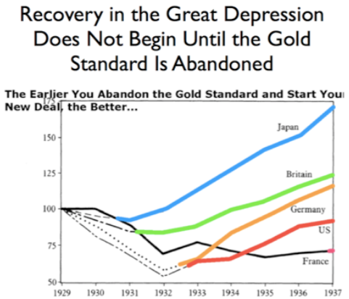
New Deals
Japan: Takahashi Korekiyo
moved early to maintain full employment
Britain: MacDonald-Snowden-Baldwin
Forced off…
Germany: Adolf Hitler
Succeeds Bruening
America: Franklin Delano Roosevelt
Succeeds Herbert Hoover
France: Leon Blum

Slide 18
Recovery
Japan recovered the fastest,
Germany second,
Britain third,
The U.S. fourth,
France last.
By-and-large, the sooner you abandon the gold standard, expand the money supply, and undertake a "New Deal" to boost government spending, the better…

Slide 19
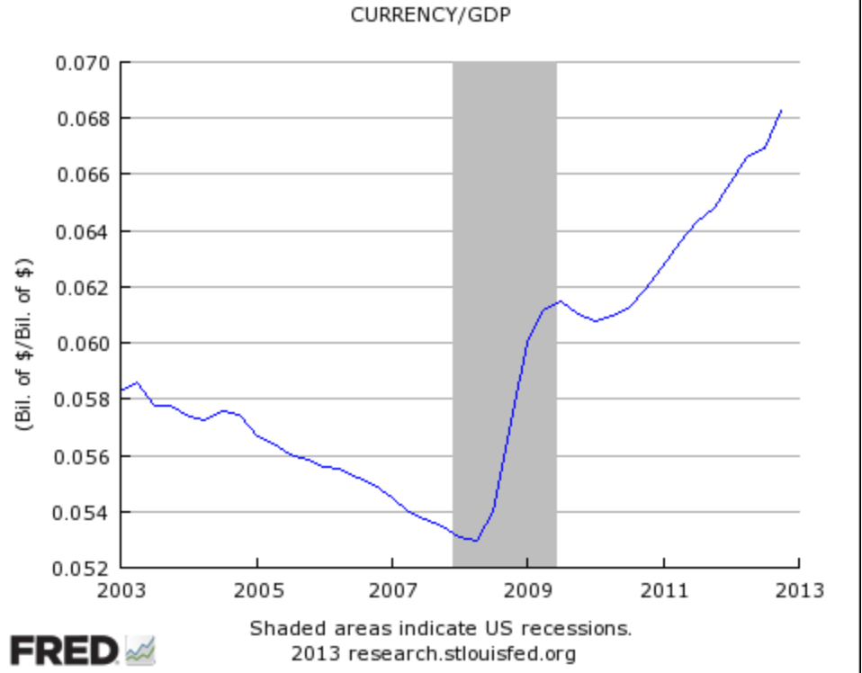
John Maynard Keynes
“It seems unlikely that the influence of banking policy on the rate of interest will be sufficient by itself to determine an optimum rate of investment:
“I conceive, therefore, that a somewhat comprehensive socialisation of investment will prove the only means of securing an approximation to full employment;
“though this need not exclude all manner of compromises and of devices by which public authority will co-operate with private initiative.
“But beyond this no obvious case is made out for a system of State Socialism which would embrace most of the economic life of the community…”

Slide 20
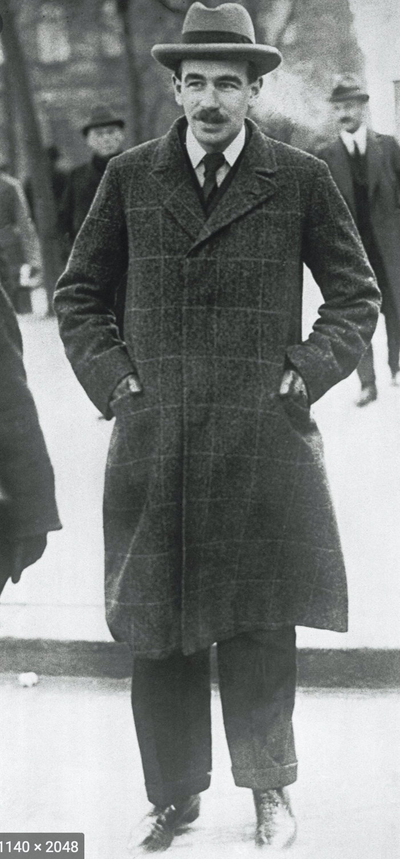
John Maynard Keynes II
“Let us clear from the ground the metaphysical or general principles:
“It is not true that individuals possess a prescriptive 'natural liberty' in their economic activities.
“There is no 'compact' conferring perpetual rights on those who Have or on those who Acquire.
“The world is not so governed from above that private and social interest always coincide.
"It is not so managed here below that in practice they coincide.
“It is not a correct deduction from the principles of economics that enlightened self-interest always operates in the public interest.
“Nor is it true that self-interest generally is enlightened….
“Experience does not show that individuals, when they make up a social unit, are always less clear-sighted than when they act separately….
“I believe that in many cases the ideal size for the unit of control and organisation lies somewhere between the individual and the modern State…”

Slide 21
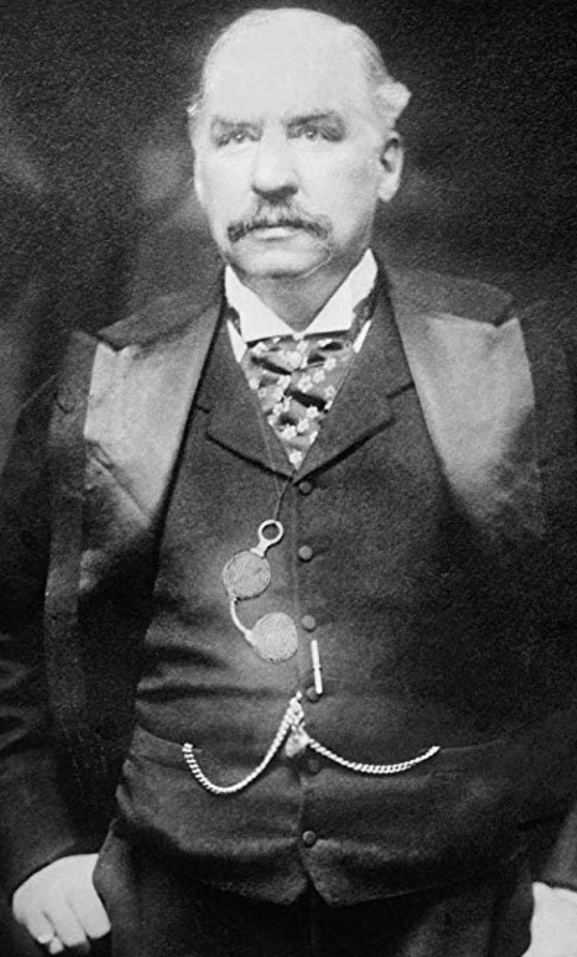
“Moderately Conservative”
John Maynard Keynes:
“Whilst, therefore, the enlargement of the functions of government, involved in the task of adjusting to one another the propensity to consume and the inducement to invest, would seem to a nineteenth-century publicist or to a contemporary American financier to be a terrific encroachment on individualism.
“I defend it, on the contrary, both as the only practicable means of avoiding the destruction of existing economic forms in their entirety and as the condition of the successful functioning of individual initiative.
“For if effective demand is deficient, not only is the public scandal of wasted resources intolerable, but the individual enterpriser who seeks to bring these resources into action is operating with the odds loaded against him…”

Slide 22
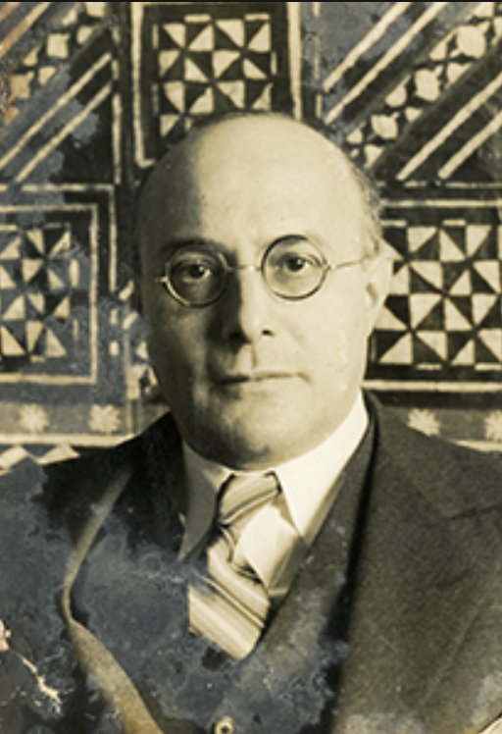
“Fictitious Commodities”: Labor
Karl Polanyi:
“In regard to labor, land, and money… to allow the market mechanism to be sole director of these and their natural environment… would result in the demoli­tion of society.
“For the alleged commodity “labor power” cannot be shoved about, used indiscriminately, or even left unused, without affecting also the human individual who happens to be the bearer of this peculiar commodity.
“In disposing of a man’s labor power the system… would… dispose of the… ‘man’ attached to that tag.
“Robbed of the protective covering of cultural institutions, human beings would perish from the effects of social exposure;
“they would die as the victims of acute social dislocation through vice, perversion, crime, and starvation…”

Slide 23
“Fictitious Commodities”: Land and Finance
Karl Polanyi:
“Nature would be reduced to its elements, neighborhoods and landscapes de­filed, rivers polluted, military safety jeopardized, the power to pro­duce food and raw materials destroyed.
“Finally, the market adminis­tration of purchasing power would periodically liquidate business enterprise, for shortages and surfeits of money would prove as disas­trous to business as floods and droughts in primitive society…”

Slide 24
“Double Movement”
Karl Polanyi:
“The double movement… the action of two organizing principles in society….
“Economic liberalism, aiming at the establishment of a self-regulating market…
“using… laissez-faire and free trade….
“Social protection aiming at the conservation of man and nature as well as productive organization,
“relying on… those most immediately affected by the deleterious action of the market… the working and the landed classes—and
“using protective legislation, restrictive associations, and other instruments of intervention as its methods…”

Slide 25
Class Interest and Public Interest
Karl Polanyi:
“Class is important.…
“The middle classes were the bearers of the nascent market economy… had no organ to sense the dangers involved in the
“exploitation of the physical strength of the worker,
“the destruction of family life,
“the devastation of neighborhoods,
“the denudation of forests,
“the pollution of rivers,
“the deterioration of craft standards,
“the disruption of folkways, and
“the general degradation of existence including housing and arts, as well as
“the innumerable forms of private and public life that do not affect profits….
"To the landed aristocracy and the peasantry fell the task of safeguarding the martial qualities of the nation which continued to depend largely on men and soil, while
the laboring people to a smaller or greater extent, became representatives of the common human interests that had become homeless.
“But at one time or another, each social class stood, even if unconsciously, for interests wider than its own…”

Slide 26
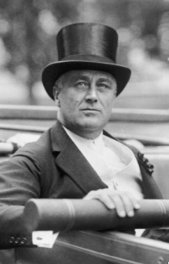
Franklin Delano Roosevelt and His New Deal
What was the alternative going to be?
Roosevelt had no idea
Try everything, and reinforce success:
Abandon the gold standard
Stop austerity
Buy farm products
NIRA—“corporatism”
Financial reform: “the money changers have been cast down from their high seats in the temple of our civilization…”
WPA
CCC
Social Security
NLRB
PUHCA

Slide 27
Social Insurance
The Beveridge Report
Post-WWII British Labour Socialism
Nationalization of the Bank of England
National Health Service
British Rail
British Steel
Pension, unemployment insurance, aid to mothers with small children
The U.S. New Deal
Social Security
AFDC
NLRA
TVA
SEC
Military Keynesianism

Slide 28
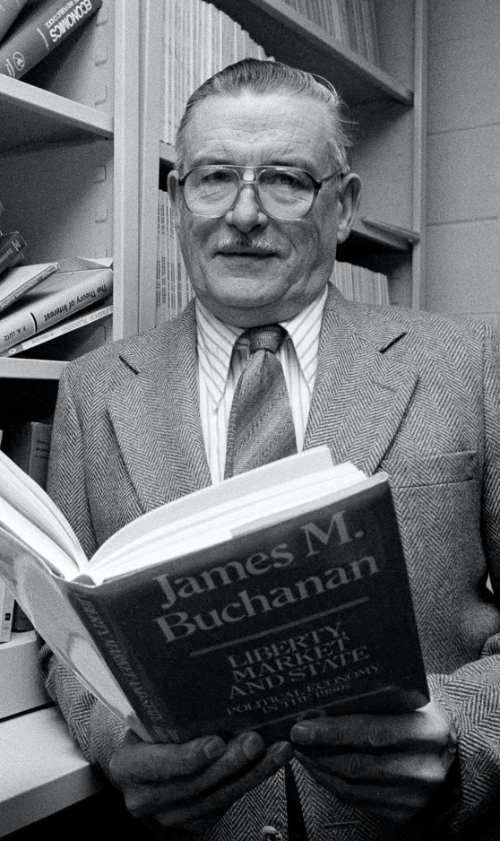
Counteroffensive from Mt. Pelerin
James Buchanan:
“The Keynesian episode in economics is… orthogonal to any attribution of progression or retrogression in the hard core of the research program of the discipline.
“The Keynesian enterprise can be interpreted as an ultimately failed attempt to jury-rig improvements on a structure of institutional constraints that were nonsustainable….
“The whole exercise [w]as an aberration that was grounded in rather elementary misunderstanding of what the classical vision of political economy embodies….
“It seems naive to think that ‘the market’… can operate effectively… adjust quickly to a dramatic reduction in the politically-influenced and unpredictable supply of money?
“It must remain forever mysterious as to why Keynes and the Keynesians were willing to neglect prospects for institutional reforms in the effective monetary constitution, while, at the same time, proposing radical changes along other more specific dimensions of policy....
“The Keynesian tragedy is locatcd in the timidity of its nostrums in the face of existing institutions, accompanied by its willingness to replace market evaluations by politicized controls over particular choice vectors (employment, investment)…”

Slide 29
To Your iClickers…
Which three politicians reacted best to the challenges of the Great Depression?
Takehashi Korekiyo, Adolf Hitler, and Franklin Roosevelt
Theodore Roosevelt, Woodrow Wilson, and Franklin Roosevelt
Herbert Hoover, Calvin Coolidge, and Neville Chamberlain
Herbert Hoover, Franklin Roosevelt, and Leon Blum
None of the above sets reacted well.

Slide 30
Alternatives to Let-It-Alone Market Society
Laissez-Faire Capitalism Failed in the Depression:
The aristocratic-landlord-military Old Order bankrupted itself with WWI.
The financial-business Old Order its insistence on austerity and on the gold standard—“tough it out” as the way to get to the other side of the Great Depression
Socialist parties had grown with urbanization, industrialization, visible high inequality, and prosperity.
Socialists, following Marx, confidently predicted that capitalist breakdown would empower left-wing revolution
But by and large the swing was to the right, rather than to the left
Except in the United States

Slide 31
What Was the Alternative Going to Be?
Socialists thought that the alternative should be some form of communism:
Collective ownership of the means of production
Conscious management of the economy to avoid “irrationalities”
Nationalists thought that the problem was that the global international economy was run for the benefit of rich foreigners and parasitic financiers
Especially Jews
Proletarian nations that were unfairly deprived of resources and markets by imperial powers (like Britain, and France), rather than proletarian classes…

Slide 32

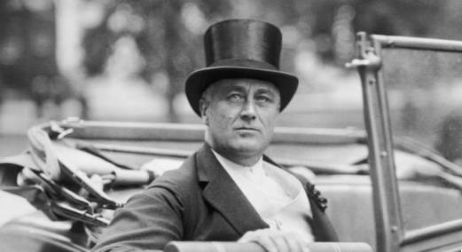
Really-Existing Socialism
An ultimately unsuccessful challenger:
Ernest Gellner:
“Just as extreme Shi’ite Muslims hold that Archangel Gabriel made a mistake, delivering the Message to Muhammed when it was intended for Ali…
“so Marxists… think… [the] message was intended for classes, but was delivered to nations.
“It is now necessary for revolutionary activists to persuade the wrongful recipient to hand over the message and the zeal…”

Slide 33
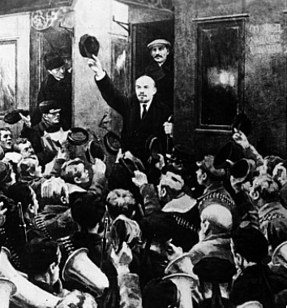
The Soviet Trajectory
Imperatives
Survive
Eliminate large-scale private property and market
Industrialize
No aid coming from Germany
War Communism
War Terror
NEP
“Scissors Crisis”
Capital as a business model
Nationalities question

Slide 34
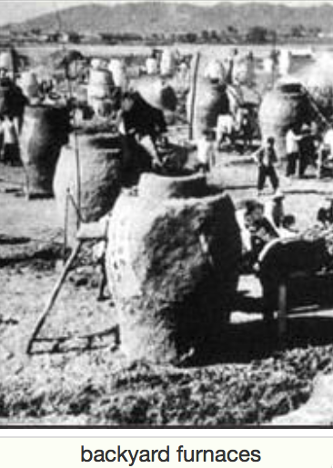
Failed Utopia: The Butcher’s Bill
Russian Civil War: 3M?
Collectivization of agriculture: 10M?
Great Terror: 2M?
Post-WWII purge: 2M?
Anti-landlordism: 4M?
Collectivization: 4M?
Great Leap Forward famine: 50M?
Cultural Revolution: 5M?
Pol Pot: 1.5M
Kim Dynasty: ????

Slide 35
The Soviet Union: Late Development
If the Soviet Union was “European” or “recent settlement”—an absolute disaster.
If you compare the Soviet Block to the countries around its edge—an absolute disaster
Why? Because bureaucracies undisciplined by markets are really not very good at organizing production
They can—sometimes—duplicate things they can see elsewhere
They can—sometimes—generate amazing feats of resource mobilization
While sharply reducing “profiteering”
When do we want “hard incentives”, anyway?

Slide 36
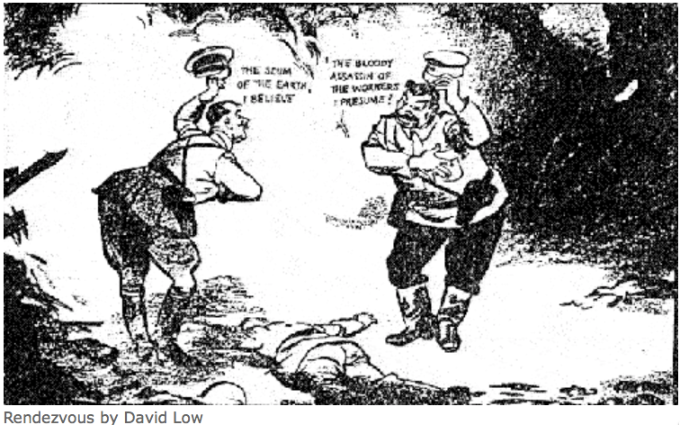
The Soviet Union: Tyranny
Should we dismiss the Soviet Union as simply a tyranny?
One in which the standard ways of bullying and oppressing people are reinforced by technologies of bureaucracy and indoctrination?
“Fake News” goes back to the Norman Conquest, after all…
We are just better at it…

Slide 37
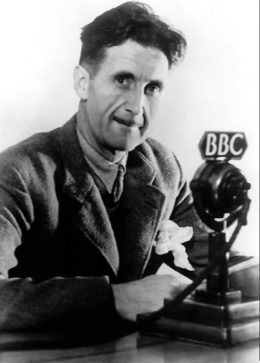
The George Orwell Tradition
George Orwell’s 1984
Estate-based authoritarianism as the natural Agrarian Age form of government
Totalitarianism as the natural Industrial Age form of government: “a boot stamping on a human face, forever…”
What is “totalitarianism”?
Is it possible?
Is it stable?
Is it a model?
Religious or quasi-religious fervor?
Cf.: Hobsbawm

Slide 38
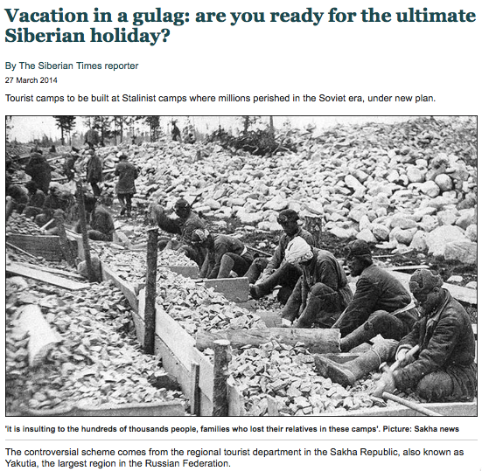
Failed Utopia: Social and Economic Organization
Max Weber: “Wherever bureaucracy gained the upper hand… it did not disappear…. State bureaucracy would rule alone if private capitalism were eliminated. The private and public bureaucracies, which now check one another to a degree, would be merged into a single hierarchy.
“This would be similar to the situation in ancient Egypt, but it would occur in a much more rational—and hence unbreakable—form… the shell of bondage which men will perhaps be forced to inhabit as powerless as the fellahs of ancient Egypt. Who would want to deny that such a potentiality lies in the womb of the future?…”

Slide 39
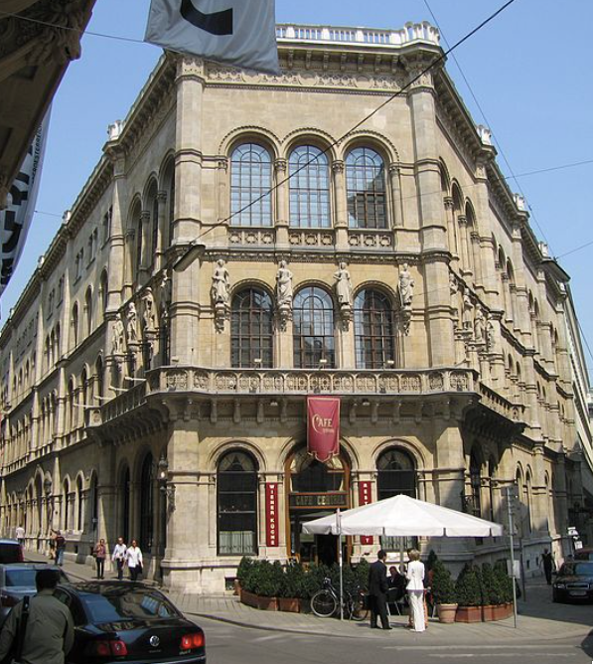
Failed Utopia: The Costs of the “Experiment”
Guenther Roth: “Weber and Schumpeter... had their famous falling-out in a Viennese coffeehouse in 1918. Weber, ‘who took nothing lightly,’ and Schumpeter, who ‘took nothing hard,’ recalled Somary who witnessed the scene, clashed over the Russian Revolution.
“Schumpeter welcomed it as a laboratory experiment…. For Weber it was going to be ‘a laboratory heaped with human corpses.’ When an enraged Weber stormed out, a smiling Schumpeter remarked: ‘How can someone carry on like that in a coffeehouse?’—the proper place for irony, never seriousness…”

Slide 40
The Butcher’s Bill: The Inner Party
Russian Civil War: 3M?
Collectivization of agriculture: 10M?
Great Terror: 2M?
Post-WWII purge: 2M?
Anti-landlordism: 4M?
Collectivization: 4M?
Great Leap Forward famine: 50M?
Cultural Revolution: 5M?
Pol Pot: 1.5M
Kim Dynasty: ????

Slide 41
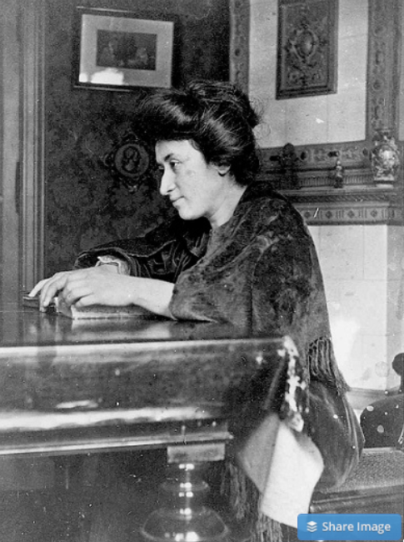
Failed Utopia: Politics
Rosa Luxemburg: “The tacit assumption underlying the Lenin-Trotsky theory of dictatorship is this: that the socialist transformation is something for which a ready-made formula lies completed in the pocket of the revolutionary party…. We [do] know more or less what we must eliminate…
“But when it comes to the nature of the thousand concrete, practical measures, large and small, necessary to introduce socialist principles into economy, law and all social relationships, there is no key in any socialist party program or textbook. That is not a shortcoming but rather the very thing that makes scientific socialism superior to the utopian varieties…”
What did Lenin do? The German war economy…

Slide 42
Failed Utopia: Politics II
Rosa Luxemburg: “In place of… general, popular elections, Lenin and Trotsky have laid down the soviets…. Public life gradually falls asleep, a few dozen party leaders of inexhaustible energy and boundless experience direct and rule… meetings… [that] approve proposed resolutions unanimously… the dictatorship of a handful of politicians…. Such conditions must inevitably cause a brutalization of public life: attempted assassinations, shooting of hostages, etc…”

Slide 43
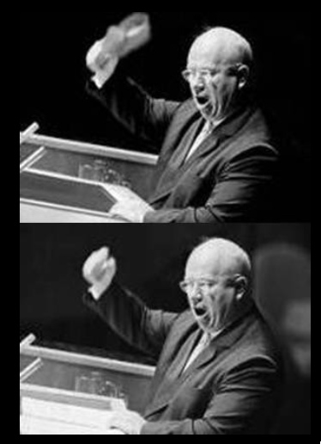
Failed Utopia: Our Friend Nikita Sergeyevitch
Francis Spufford: “So much blood, and only one justification for it…. If it had been all prologue, all only the last spasms of death in the old, cruel world…. Today the radio was reporting… Prague….
“He fumbled with the tape machine… found the RECORD key…. ‘Paradise’, he told the wheat field in baffled fury: ‘is a place where people want to end up, not a place they run from. What kind of socialism is that? What kind of shit is that, when you have to keep people in chains. What kind of social order? What kind of paradise?…’
“And then… the retired monster sat very still on the bench by the field…”

Slide 44
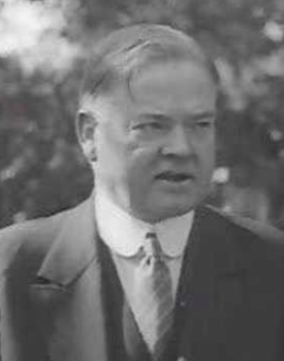
Herbert Hoover and Austerity
1932: This message is “devoted solely to the necessity for balancing the budget…. Nothing is more necessary…. Nothing will put more heart into the country than prompt and courageous and united action…. The details and requirements… are now well known… plainly require: 1. The prompt enactment of a revenue bill…. 2. A drastic program of economy…”

Slide 45
Franklin Delano Roosevelt and His New Deal
What was the alternative going to be?
Roosevelt had no idea
Try everything, and reinforce success:
Abandon the gold standard
Stop austerity
Buy farm products
NIRA—“corporatism”
Financial reform: “the money changers have been cast down from their high seats in the temple of our civilization…”
WPA
CCC
Social Security
NLRB
PUHCA

Slide 46
Franklin Delano Roosevelt and His New Deal II
Keynes: “I think there is a great deal to be said for the ownership of all the utilities by publicly owned boards. But if public opinion is not yet ripe for this, what is the object of chasing the utilities around the lot every other week?…
“A convincing policy, whatever its details may be, for promoting large-scale investment under the above heads is an urgent necessity. These things take time. Far too much precious time has passed. I must not encumber this letter with technical suggestions for reviving the capital market. This is important.
“But not so important as the revival of sources of demand. If demand and confidence reappear, the problems of the capital market will not seem so difficult….
“Forgive the candour…. They come from an enthusiastic well-wisher…. I am terrified lest progressive causes… suffer injury, because you have taken too lightly the risk… from a failure measured in terms of immediate prosperity. There need be no failure.
“But the maintenance of prosperity in the modern world is extremely difficult; and it is so easy to lose precious time…”

Slide 47
And Yet There Was Optimism in the 1930s…
The “economic problem” not the permanent problem of the human race
John Maynard Keynes thought that the economic problem would not be the "major problem of the human race"
By the end of the twentieth century the human race would be so rich that people would be practically satiated with commodities.
Thus the "economic problem" of how to economize and be efficient, and allocate scarce means among alternative uses, was not the permanent problem of the human race.
Instead, "for the first time since his creation man will be faced with his real, his permanent problem-how to use his freedom from pressing economic cares, how to occupy the leisure, which science and compound interest will have won for him, to live wisely and agreeably and well.... It will be those peoples, who can keep alive, and cultivate into a fuller perfection, the art of life itself and do not sell themselves for the means of life, who will be able to enjoy the abundance when it comes..."
Yet Keynes was not sure that having to confront this problem would be a net plus for humanity: "Will this be a benefit? If one believes at all in the real values of life, the prospect at least opens up the possibility of benefit. Yet I think with dread of the readjustment of the habits and instincts of the ordinary man, bred into him for countless generations, which he may be asked to discard within a few decades..."

Slide 48
Takeaways
Understanding the Great Depression

Slide 49
Preview: Next Time
After the midterm, we will go into “really existing socialism”…
Lenin
Trotsky
Stalin
Khrushchev
Brezhnev
Andropov
Chernenko
Gorbachev

Slide 50
What Was Unconvincing Today?
Mistakes and unclarities: typos, wordos, and mindos…
In the DRAFT textbook?
In the lecture?

Slide 51
Catch Our Breath…
Ask a couple of questions?
Make a couple of comments?
Any more readings to recommend?

Slide 52
Notes

